Slide 1
How To Create a CFA
Created by Kayla Spies and Julie Lindner

Slide 2
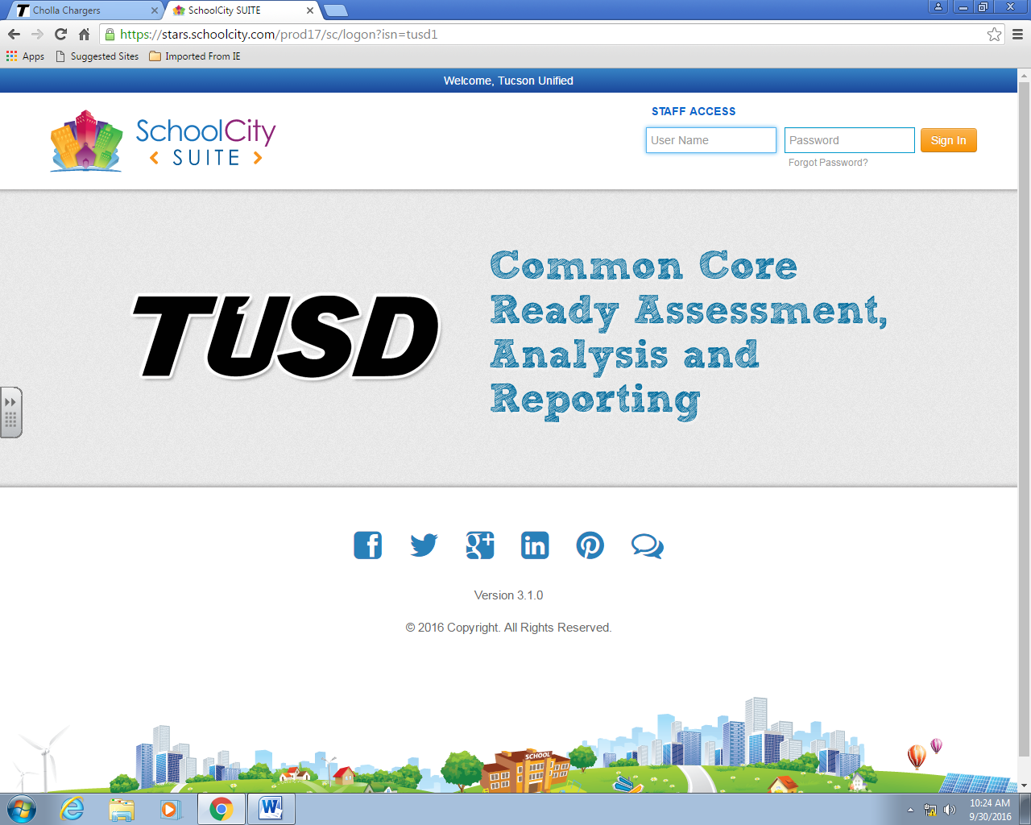
Log on to SchoolCity using the same username and password you use to log on to a computer

Slide 3
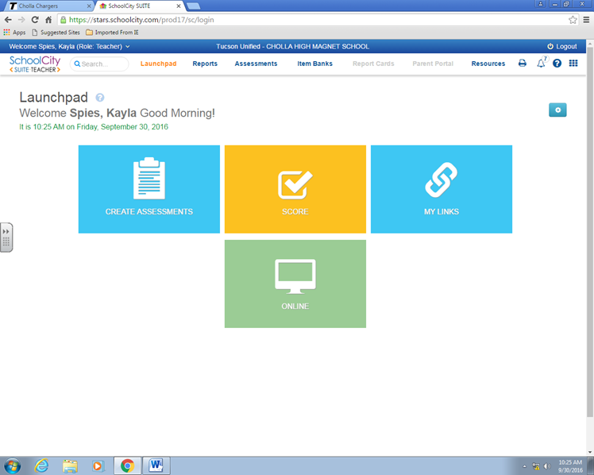
Click on Assessments

Slide 4
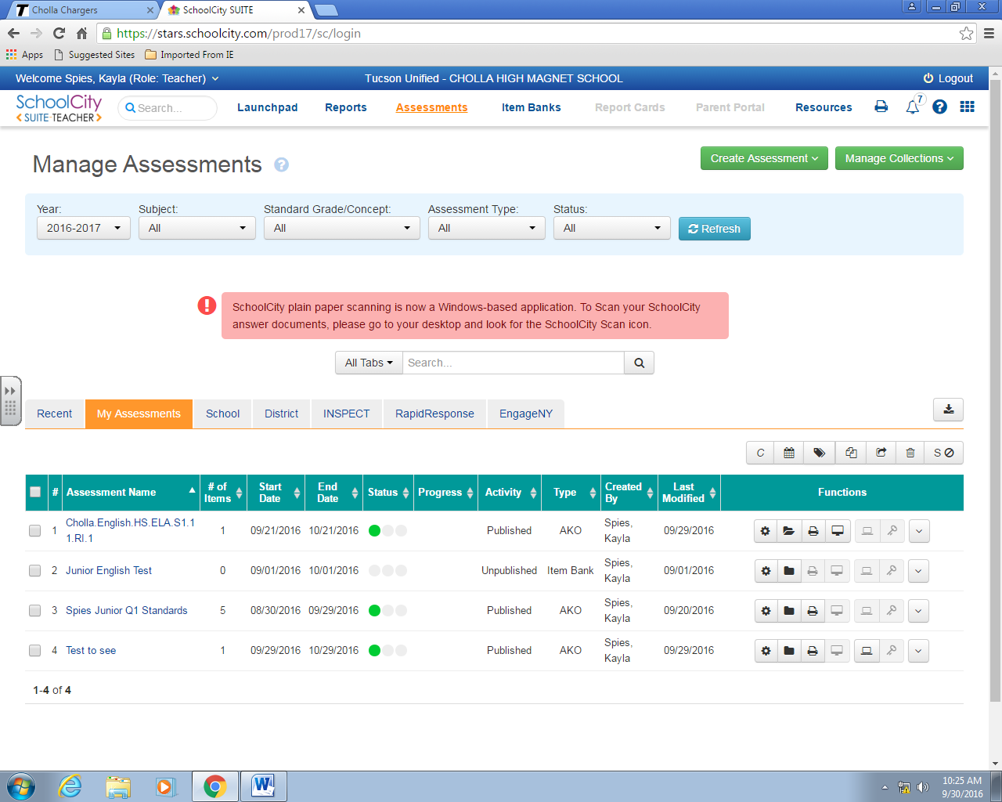
Click on Create Assessment
Select Answer Key Only (AKO)

Slide 5
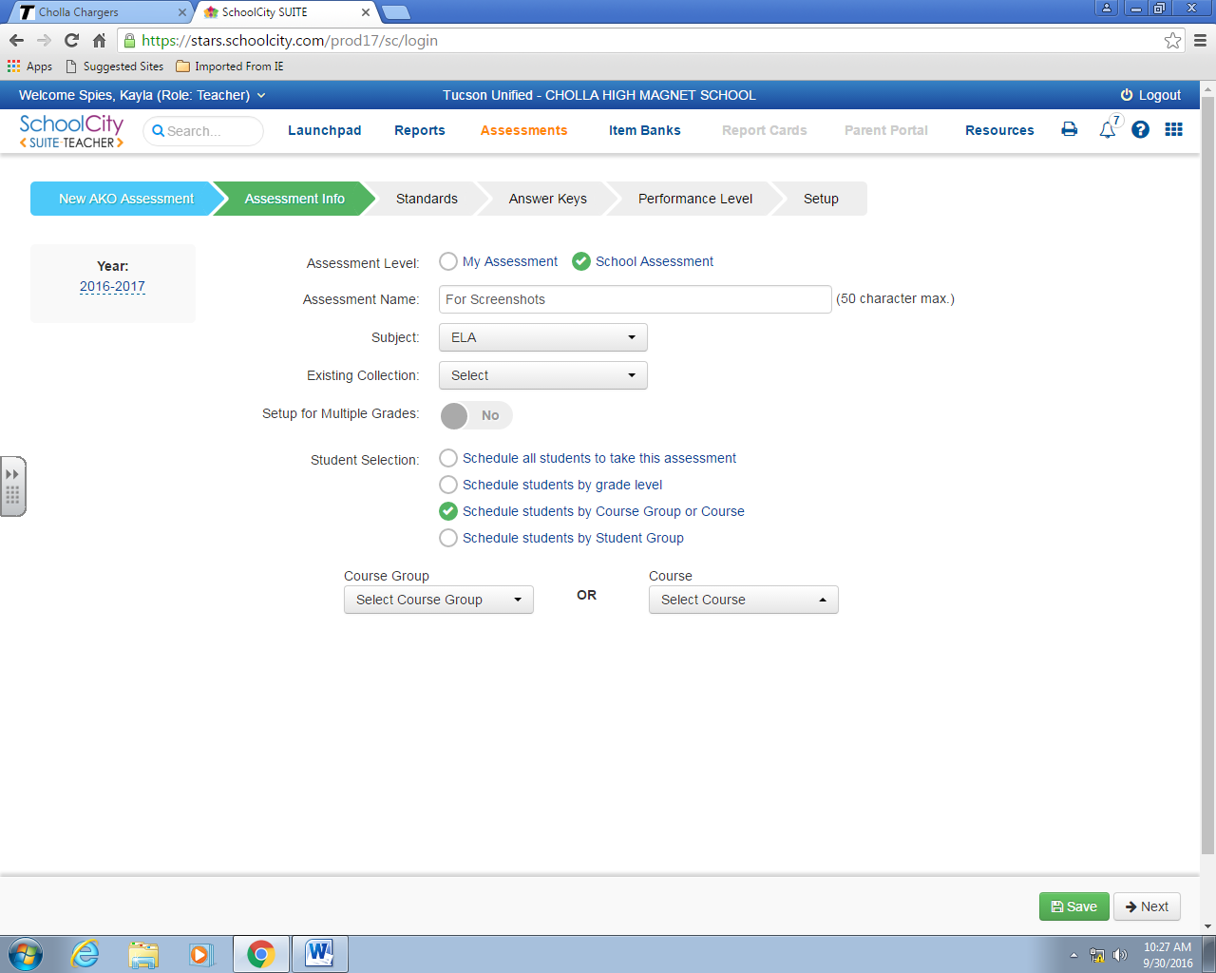
Click on School Assessment
Click on Course Group or Course
Your title should follow the format:
Cholla.Subject.HS.S1.GradeLevel.Standard
Change what is bold and underlined
Pick your course
Click Next

Slide 6
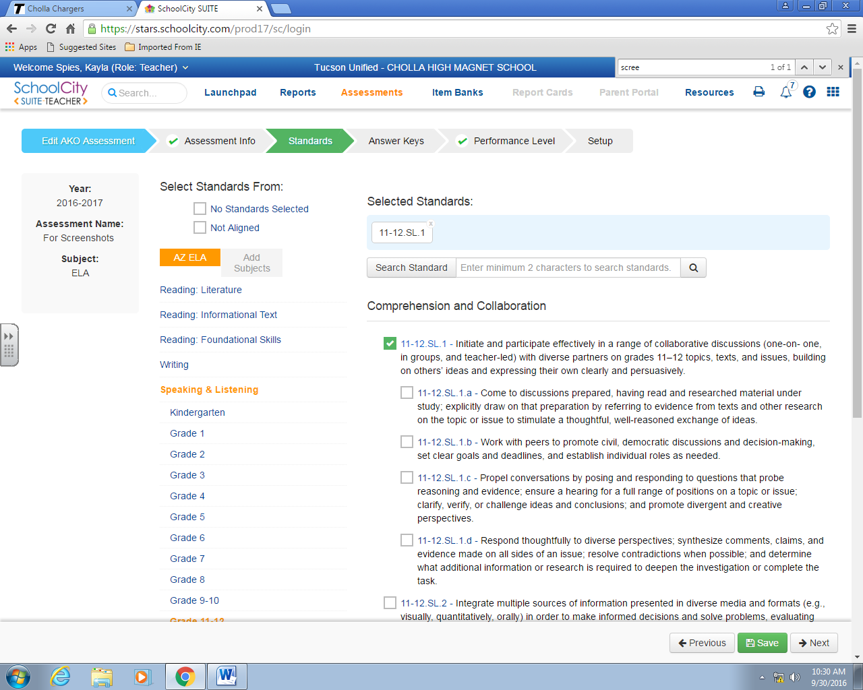
Select specific standards
Choose your standards and grade level
Click Next

Slide 7
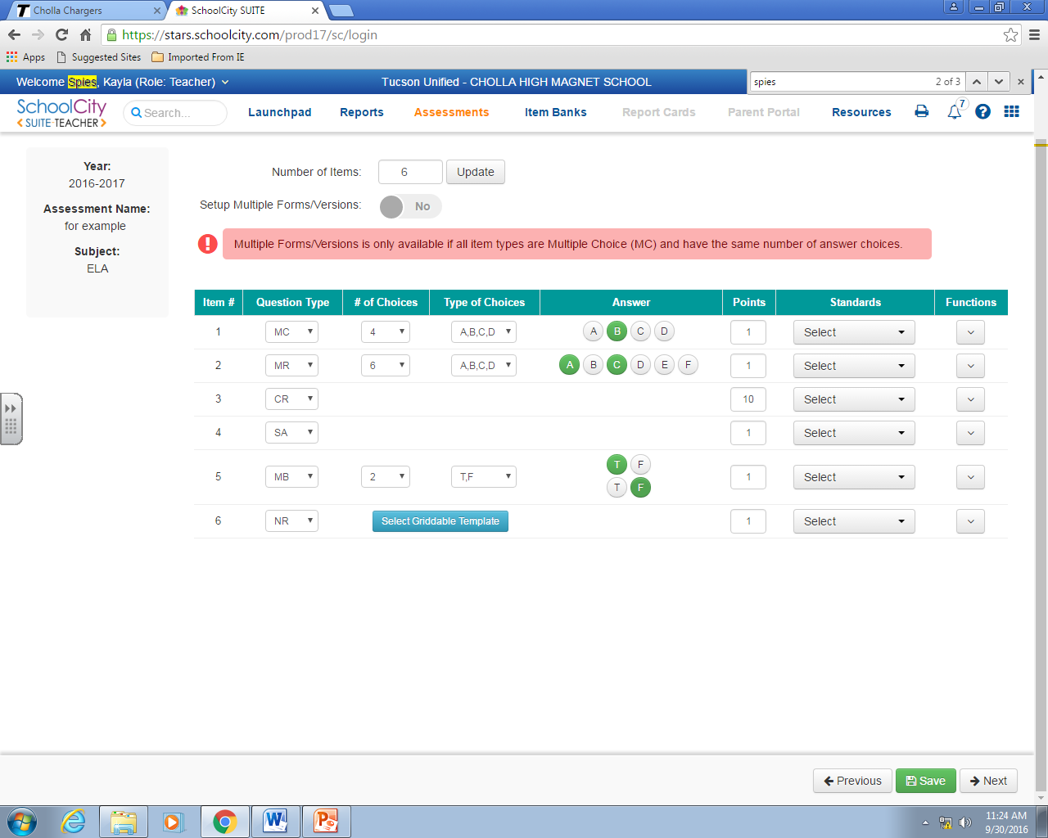
Enter how many items you will have on your assessment
Then Click Update
Question Type Key
MC=Multiple Choice
MR=Multiple Response
CR=Constructed Response
SA=Short Answer
MB=Multiple Binary
NR=Numeric Response
Choose your question type, # of choices, types of choices, correct answer, and point value
Click Next

Slide 8
Click Skip Performance Level
Click Next

Slide 9
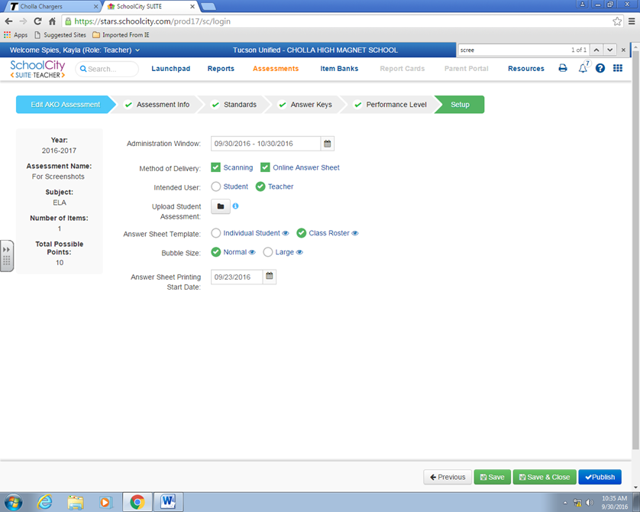
Pick the dates that align with your IFC
Switch Intended User to Teacher unless giving on line
Upload a PDF version of your CFA – may do this later
Click on class roster
Last, save and Publish

Slide 10
How to manually grade your CFA

Slide 11
Share
Delete
copy
This icon will allow you to manually grade

Slide 12
You may choose to enter all classes at once or only one at a time. Must hit refresh for your choices to take effect
Enter students answers
Make sure to hit save

Slide 13
How to Access the scores

Slide 14
Click on reports
Click on test results

Slide 15
Find your assessment
1
Correct subject
click
To print
Make sure it is on the right year

