Slide 1

School City Training
August 2015
TUSD

Slide 2
Objective
Understand how to navigate the TUSD School City STARS Suite program for administering and taking online assessments.

Slide 3
Agenda
STAFF Portal vs. STUDENT Portal
Exploring the STAFF Portal
Exploring the STUDENT Portal

Slide 4

The following video is also embedded in your required True North Logic Portal Course. This provides a preview of what is covered today.
If you have trouble loading this video above follow this hyperlink:
https://youtu.be/I9eZWC9PS8g
Notes:
Teachers will be required to complete a True North course which has a brief quiz at the end. One of the quiz questions is- were you able to successfully log in. If teachers answer “no” a representative can contact them next week and trouble shoot the issue.
This video recaps steps needed to administer an online assessment through School City.
The video is embedded and can play when in slide show mode. If you have issues viewing the embedded video, please click on the hyperlink.

Slide 5
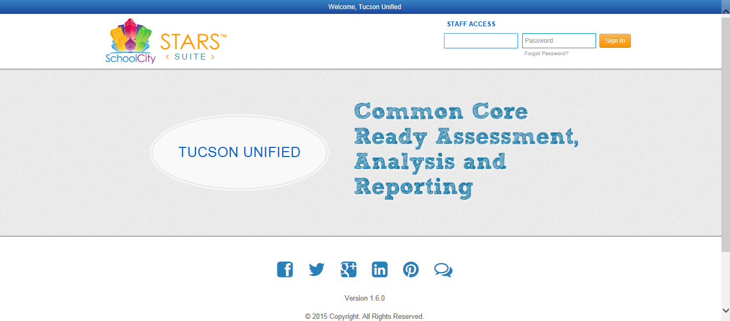
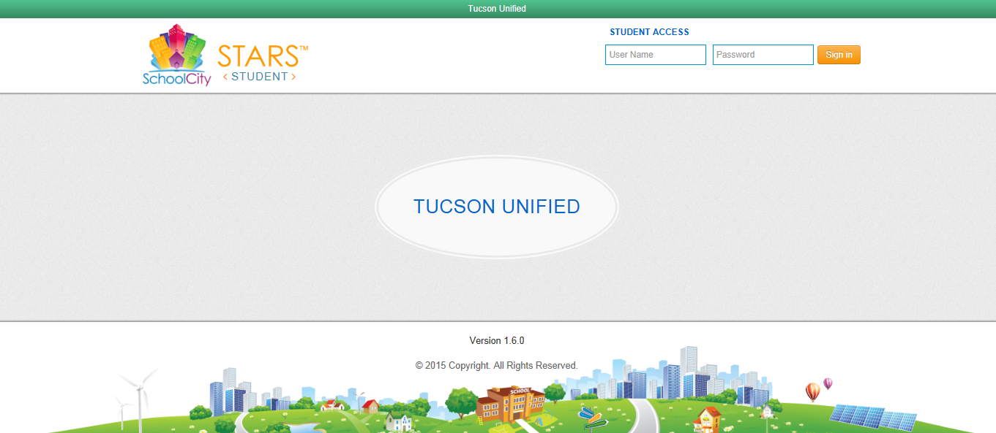
STAFF Portal vs. STUDENT Portal
?
Notes:
There are two different School City systems. A staff portal and a student portal. Both are browser agnostic- meaning they can use Internet Explorer or Chrome or Firefox. A user can denote the difference between the portals by the top title bar. The staff portal is blue whereas the student portal is green. A student cannot log into the staff portal and a staff member cannot log into the student portal. Students will access their portal from a kiosk they activate from the CTRL+ALT+DELETE screen. (covered more in depth later). Staff members presently need to go through the website log in- however, there is a kiosk in development.

Slide 6
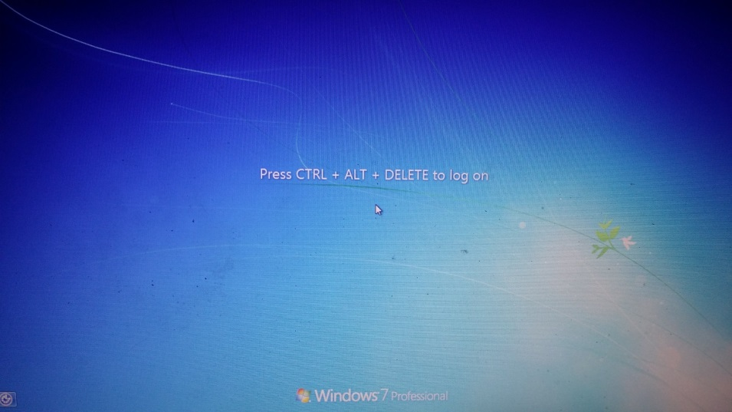
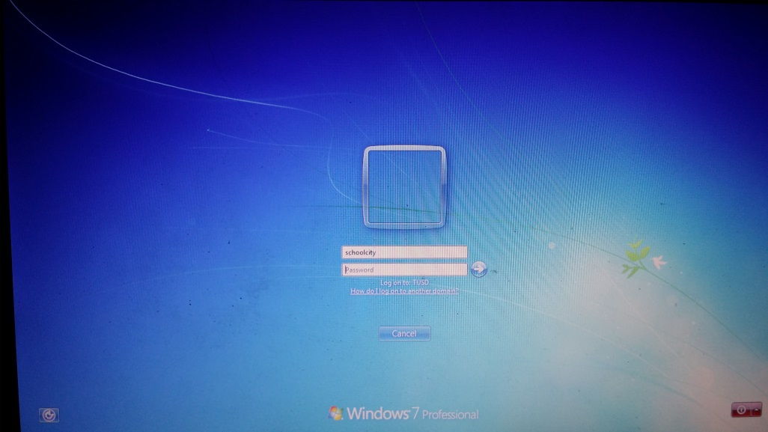
Accessing the School City STUDENT Kiosk
IMPORTANT: Give clear instructions prior to students sitting in front of the computer that they are not to log on with their credentials
After pressing CTRL+ALT+DELETE you will be prompted for User Name and Password
User Name: schoolcity
Password: schoolcity
Note: Password is case sensitive
Students will be taken directly to the STUDENT Portal after entering the above credentials
Notes:
For students- you/they will enter from the CRTL+ALT+DELETE screen the user name: schoolcity password: schoolcity The password is case sensitive and there is no space between the words. This will open the student portal. Students will only have the ability to access the school city student portal. The portal will automatically load. The kiosk was created to speed up log ins- foregoing the need to import all of their personal settings and alleviate some issues pertaining to how many people can log in per access point (square with blue light in each room).
Take Away: You will need to tell students not to log into the computer when they sit down until they have this information or they could occupy the computer for minutes waiting for their information to load. Have them log into schoolcity/schoolcity and they will be sent to the student portal.

Slide 7
Website for STAFF Portal
Please write this down:
Do not type www. this is will take you to the marketing site for School City
Tusd1.schoolcity.com
Note: DO NOT USE THE BACK BUTTON!
Doing so will log you out of the system
Notes:
The School City STARS Suite is a web based which allows users to access the system from places outside the district network. Meaning, if you wanted to build assessments or review reports/data from remote locations, such as your residence, you may do such. The most common mistake when accessing the STAFF portal is that a user types in www. Once this is done once, it saves in their cache and will continue to take them there unless- the user types in the correct address and hits, for example, the right arrow key so that it does not import from the cache/history.

Slide 8
Exploring the STAFF Portal
  Accessing the web site and logging in
  Creating and using the Online Flip Card
  Using the Assessment link or More… option from Flip Card
  Activating assessments or generating a pin

Slide 9
STAFF Portal
Notes:
In this section will we will illustrate how to access and log into the STAFF portal.

Slide 10
Computer Log On
Network Password
The BLUE TITLE BAR at the top, in addition to STAFF ACCESS above the user name denotes this is the STAFF PORTAL.
  Note: Staff cannot log in with their credentials to the Student Portal.
Staff log in information is the same they would normally use to personally log into the computer at the CRTL+ALT_DELETE screen.
  Every teachers’ log in is their computer log on and network password.
Reminder: the following site is available for staff outside the district network.
Notes:
After having typed in the URL: tusd1.schoolcity.com a load balancer will redirect users to this screen. Their URL will no longer show tusd1.schoolcity.com. This is normal. The load balancer redirects each user to the least used server. If you’re going to save a favorite- make sure to alter the favorite to tusd1.schoolcity.com through either the edit (Chrome) or properties (Internet Explorer) option available when you right click on the favorite. Otherwise- you will always go to the same server- resulting in slower downloading/uploading. This is the general log in page for STAFF users.

Slide 11
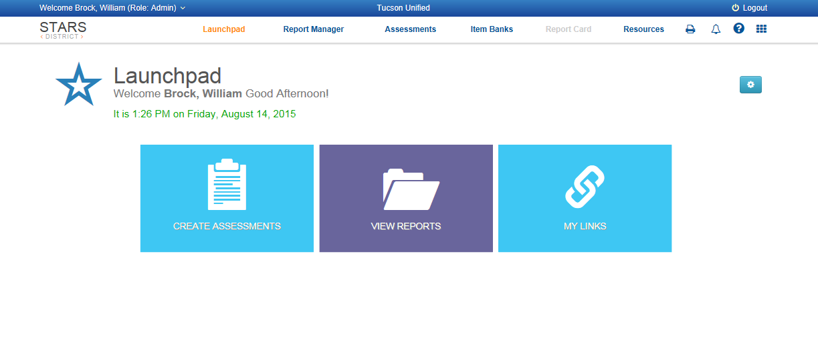
Launchpad Flip Cards
Settings
Flip Card
When teachers log in for the first time they will more than likely not see the online Flip Card on their Launchpad.
The ONLINE Flip Card can be added by checking the box in the Settings menu and saving. After saving the Online Flip Card will appear and will continue to appear on each log in.
Notes:
Upon logging in the user will be taken to the Launchpad. Note that the Launchpad is customizable. The Flip Cards may not appear in the same order or in same color.

Slide 12
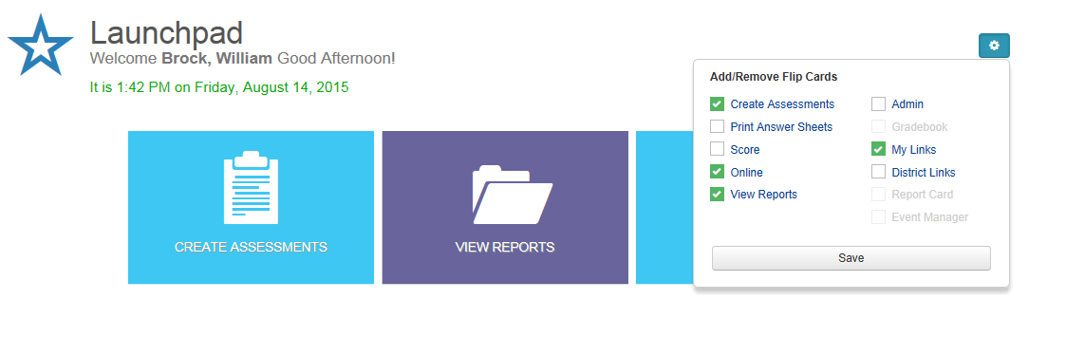
Adding a Flip Card
Select Online then Click Save
Notes:
Often times the easiest way to access a recent assessment is through the Online Flip Card. If the Online Flip Card does not appear it can be added by clicking the gear/settings icon, checking Online, and clicking save. The Online Flip Card will appear after clicking save.

Slide 13
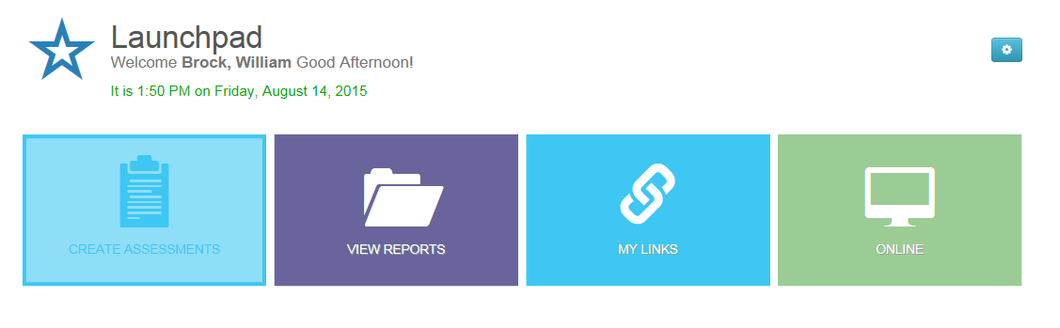
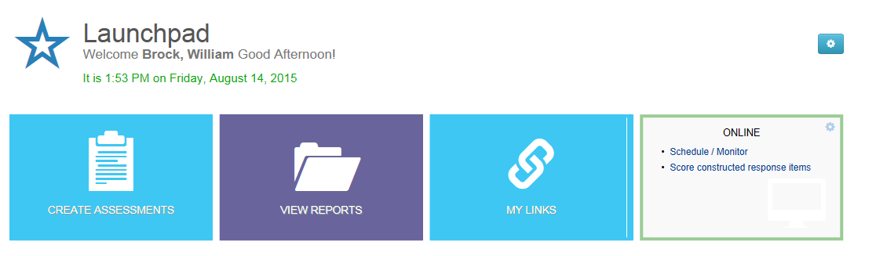
Flip the Online Flip Card by left clicking once
Select Schedule/Monitor
Notes:
Turn over the Online Flip Card by left clicking once. Select Schedule/Monitor.

Slide 14
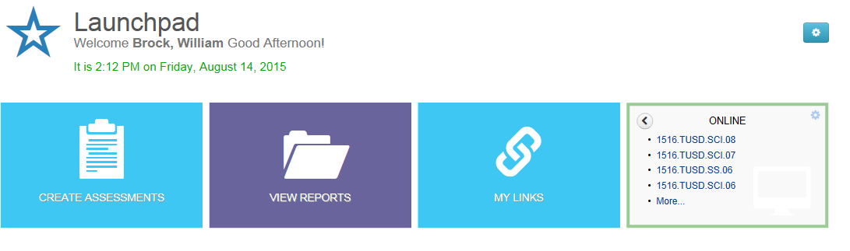
If you see your assessment you may select it from here. If not, you may select More… for list of all exams
HOW DO I KNOW WHICH TEST IS MINE????
Assessment Level
i.e. District/School/Teacher
Subject
1516.TUSD.ELA.03
School Year
Grade Level
Notes:
After selecting Schedule/Monitor you will see a list of assessments. In the pre-test for Teacher Growth Evaluation teachers and students will see the following naming protocol. The subject and grade level will be the only area changing for this test. You ask your staff to check for understanding the following question: A math teacher in the 4th grade would select what test? Answer: 1516.TUSD.MATH.04
A list of assessments title will be published and distributed at a later time. If you do not see your assessment there, click More... to access the Assessment page. If your assessment is present- you may click on the assessment from the Online Flip Card and jump straight to the roster select screen (shown later in this PowerPoint).

Slide 15
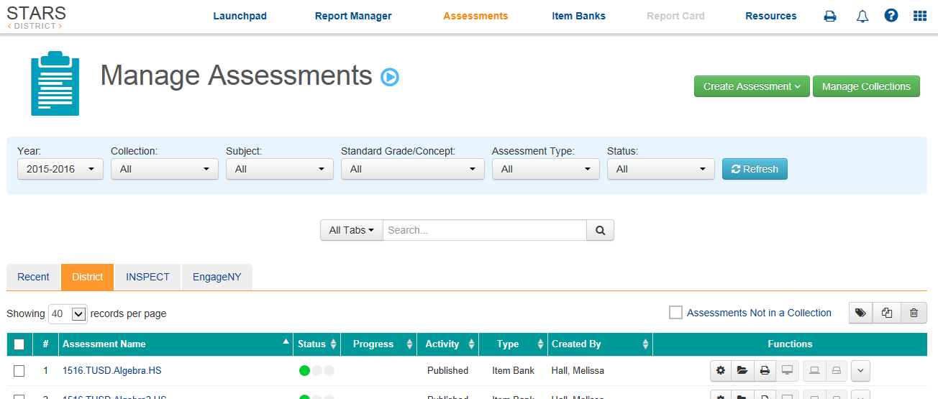
Alternative to Using the Online Flip Card
From the menu at the top you may click Assessments to access the page below in order to find your assessment of interest
    If you clicked More…. on the Online Flip Card you will be going to the same location.
Notes:
If you choose to not utilize the Online Flip Card you may click on the Assessment hyperlink from the white navigation bar at the top. If you click More… on the Online Flip Card, these links will take you to the same place. If you clicked on the name of the assessment from the Online Flip Card you would skip this screen and be taken directly to the class roster.

Slide 16
If you successfully selected the correct assessment from the online Flip Card you DO not have to do this step!
Please select the District tab to see District level assessments. You will know it is selected by the tab being highlighted orange.
CLICK
Notes:
Teachers may see an additional tab on this screen labeled “My Assessments”. For District published assessments, click on the District tab. Again, if you successfully found the assessment on the Online Flip Card, you would not have to complete this step. By clicking on the District tab you will see District level assessments that may be given to students on your rosters.

Slide 17
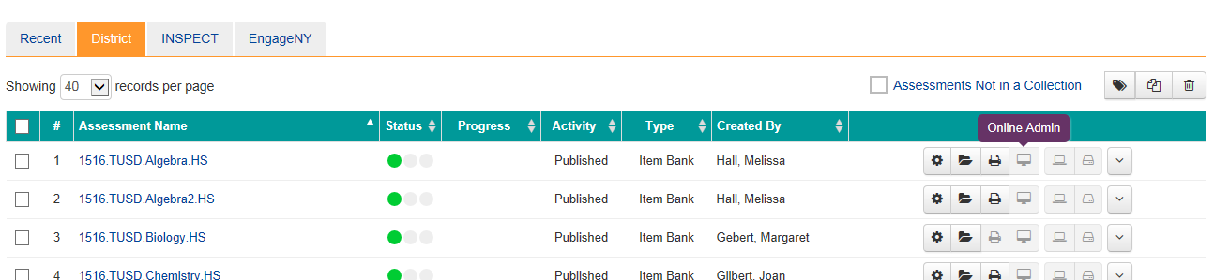

CLICK
ONLINE ADMIN
Locate the assessment of interest and follow the row to the right and select the Online Admin button.
This will take you to a screen that will allow you to select your roster.
Notes:
Once you have located the assessment of interest, follow the row across from the name and click on the icon that resembles a monitor. If you hover your mouse over the icon it will indicate it is the icon for Online Admin. Please select this icon to be taken to your roster page.

Slide 18
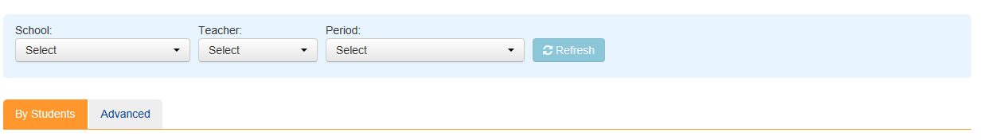
CLICK REFRESH
IMPORTANT: If applicable, select period for assessment then click REFRESH to populate your roster! Otherwise you will not see your students.
Notes:
In the School City program- one user can give one assessment to a single roster at a time. Middle and High School Procedure: courses such as P.E., Fine Arts, and CTE will have one test across grade levels. For example, in a single period of P.E. the roster may contain students from grades 9 through 12. This P.E. instructor will administer one test to the entire roster. Elementary is different: In elementary schools with combo classes, you will send one grade level at a time for testing. For example, in a combo class of 3rd and 4th graders, the teacher will test their 3rd graders first. Once they have finished and all logged out, then the teacher can set up a session for their 4th graders or vice versa. If there are unforeseen instances in middle school or high school where a single roster requires multiple tests to be administered, please inform administration and the district will provide guidance.

Slide 19
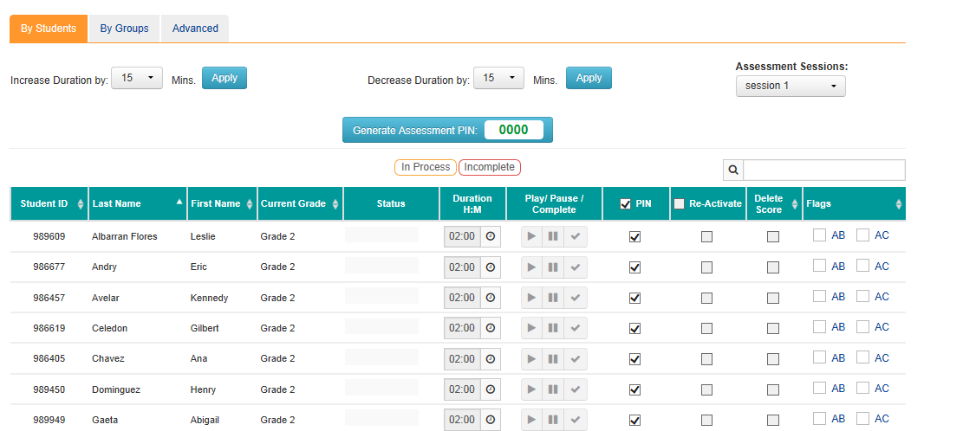
POSSIBILITY 1: NEED TO GENERATE A PIN
(For Middle and High Schools)
Assure all students you want to take the test are selected or select all students by checking the PIN global check box
Click Generate Pin Button and give the students the number
2: CLICK GENERATE BUTTON
1: Assure Checked
Notes:
Whether or not a teacher will need to activate the assessment or generate a pin is based on the grade level and is controlled by the test creator. Depending on your grade level you will either need to generate a pin or activate the test. If you teach at the middle or high school level you will be prompted to generate a pin. The processes of activating a test or generating a pin are nearly identical. The difference is generating a pin is an extra step in security. Students will then need to be given a pin to access the test. To generate a pin, use the global check button to select all students and then click Generate Pin Assessment. Students will not see the exam until you generate a pin for the assessment. Note: The pre-test for the Teacher Growth Assessment is timed and will already be set to the pre-set time (40 minutes). The timer is activated as soon as the student enters the test.

Slide 20
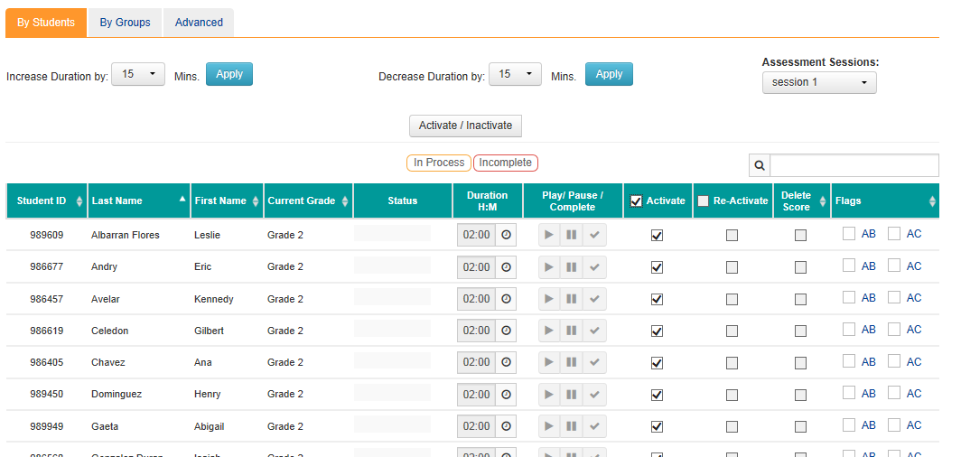
POSSIBILITY 2: NEED TO ACTIVATE ASSESSMENT
(For Elementary Schools)
Assure all students you want to take the test are selected or select all students by checking the Activate global check box
Click Activate/Deactivate Button and give the students the number
2: CLICK ACTIVATE BUTTON
1: Assure Checked
Notes:
Whether or not a teacher will need to activate the assessment or generate a pin is based on the grade level and is controlled by the test creator. If you teach in elementary school you will be prompted to activate the test. Use the global check button to select all students. Then click the Activate/Inactivate button to make the test accessible to students. A teacher may deselect those that are absent but would need to reactivate them if they were only tardy and not absent. Recommendation: at this time- activate the entire class. Once you have activated the test- students will see their assessment under their assessment Flip Card (to be shown in next slides). Students will not see a test that has not been activated. Students will also not see tests outside of the assessment window.
Whether you have generated a pin or activated the test- if you have completed up to this point, you will have successfully made the assessment available to the school.

Slide 21
Exploring the STUDENT Portal
  Kiosk Log In
  Using the Take Assessment Flip Card
  Submitting the assessment
  Logging out

Slide 22
Accessing the School City STUDENT Kiosk
IMPORTANT: Give clear instructions prior to students sitting in front of the computer that they are not to log on with their credentials
After pressing CTRL+ALT+DELETE you will be prompted for User Name and Password
User Name: schoolcity
Password: schoolcity
Note: Password is case sensitive
Students will be taken directly to the STUDENT Portal after entering the above credentials
Notes:
For students- you/they will enter from the CRTL+ALT+DELETE screen the user name: schoolcity password: schoolcity The password is case sensitive and there is no space between the words. This will open the student portal. Students will only have the ability to access the school city student portal. The portal will automatically load. The kiosk was created to speed up log ins- foregoing the need to import all of their personal settings and alleviate some issues pertaining to how many people can log in per access point (square with blue light in each room).
Take Away: You will need to tell students not to log into the computer when they sit down until they have this information or they could occupy the computer for minutes waiting for their information to load. Have them log into schoolcity/schoolcity and they will be sent to the student portal.

Slide 23
STUDENT Portal
Notes:
In this section you will have an opportunity to see and learn what students must do to access the assessment. Recall: There are two different School City systems. A staff portal and a student portal. The staff portal is blue whereas the student portal is green. A student cannot log into the staff portal and a staff member cannot log into the student portal. Students will access their portal from a kiosk they activate from the CTRL+ALT+DELETE screen.

Slide 24
User Name = Matric Number
Network Password
The GREEN BAR at the top, in addition to STUDENT ACCESS above the user name denotes this is the STUDENT PORTAL.
  Note: Teachers cannot log in with their credentials to the Student Portal.
Students log in information is the same they would normally use to personally log into the computer at the CRTL+ALT_DELETE screen.
  Every students’ log in is their MATRIC number and unique password.
  If a student forgets their password refer to this document for direction on using TUSDKids kiosk to reset their password: http://intranet/ts/Documents/TUSDKIDS.pdf
Computers that are unable to utilize the kiosk- the following site is available for students. online.schoolcity.com/tusd1 (DO NOT TYPE WWW)
Notes:
It would be a good idea to test that your entire class can access the kiosk prior to testing. Access points in classrooms are somewhat limited. Testing more than 30 people (without kiosk access) may not work. --- The good news, if a students’ network were to get dropped- they will be able to log back in and go back to the question they were on. It saves each question as you go.
Teachers will want to print out and bring with them to the testing area a list of their students matric number in the event a teacher does not recall their matric number.
If you type in www. you will be redirected to the general School City web site. This is a common mistake for both teachers and students using the portal. Also- depending on the version and individual setting of the browser- the www. auto populates. The link on how to use TUSDKids is embedded. This kiosk allows a teacher to reset a students password if it is not recalled.

Slide 25
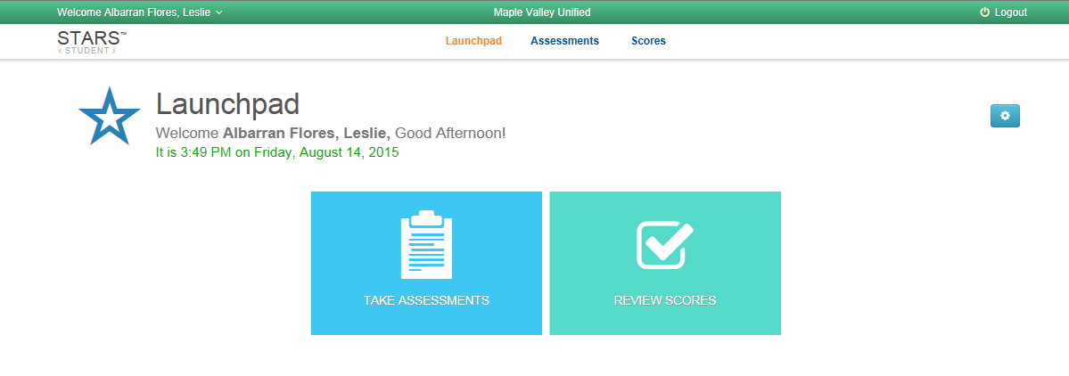
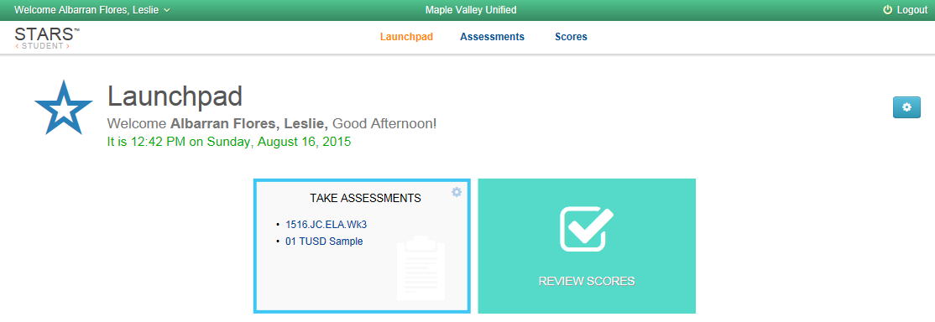
After logging in, students will be taken to their Launchpad
Like the STAFF Portal, in the STUDENT Portal there are Flip Cards for students.
Students may Flip over their TAKE ASSESSMENT Flip Card and locate their assessment.
Staff must activate the test or generate a pin (test specific) for a student to see the exam.
CLICK
Select Assessment and CLICK
Notes:
Students will not see the test if the teacher has not activated the test or generated a pin. If the staff member selected the activate button, when a student clicks on the assessment it will begin immediately. If the staff member generated a pin, the student will be prompted for the pin number after clicking on the assessment. Scores from the pre-test of the teacher evaluation will not show in the review score Flip Card.

Slide 26
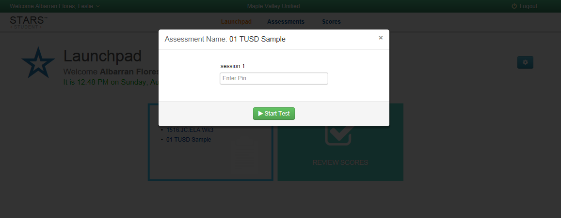
If required students will insert their PIN here, when prompted after clicking on the correct assessment
Notes:
If the assessment requires a PIN the student will be prompted by a window for the PIN number after selecting the assessment from the Online Flip Card.

Slide 27
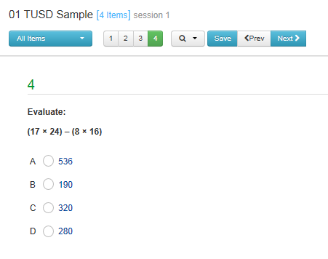
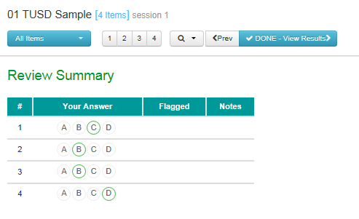
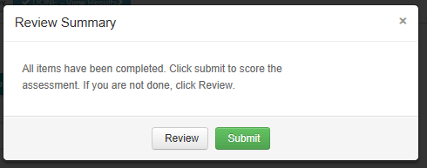
After answering the final question students can click Next> button to be taken to the summary screen. This will show them if they have omitted any questions.
CLICK
If the student is satisfied with their answers they may select
DONE. Students will not be able to review the results of the pre-test of the Teacher Growth Assessment.
CLICK
CLICK
As the last check , students will be asked to click SUBMIT.
Notes:
When students hit the next button, their answer saves and they are forwarded to the next question or, if it is the last question a summary of their answers. Students do not have to save each answer. The save is there for if the student has selected an answer- and has not progressed to the next question.

Slide 28
After submitting the assessment students may log out using the Logout button in the top right.
CLICK
To show your understanding of how to navigate the TUSD School City STARS Suite program for administering and taking online assessments, continue to True North Logic Portal and complete the required.
Questions?
Notes:
After submitting the assessment a student may log out by using the Logout button in the top right corner. If the student does not see the button/the button does not appear the student may completely log out of the system using CRTL+ALT+DELETE.
Principals- if you do not know the answer to a question, you may email schoolcityhelp@tusd1.org

