Slide 1
Extra Credit

Slide 2
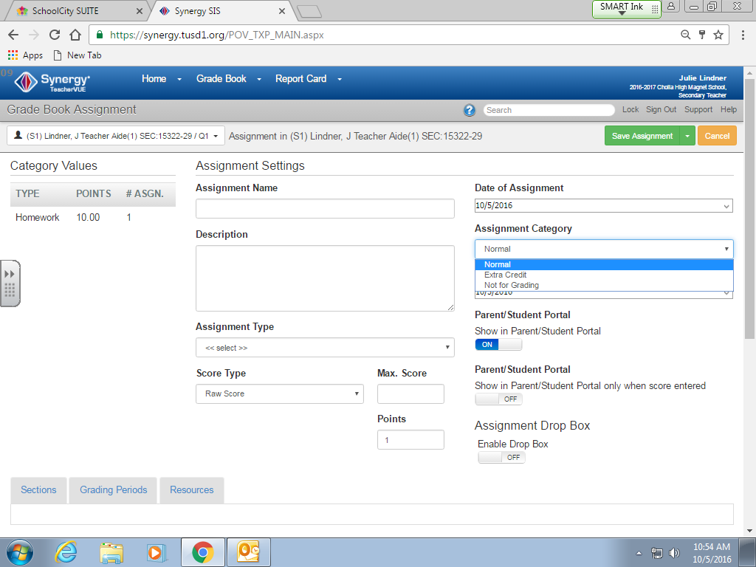
Click on extra credit

Slide 3
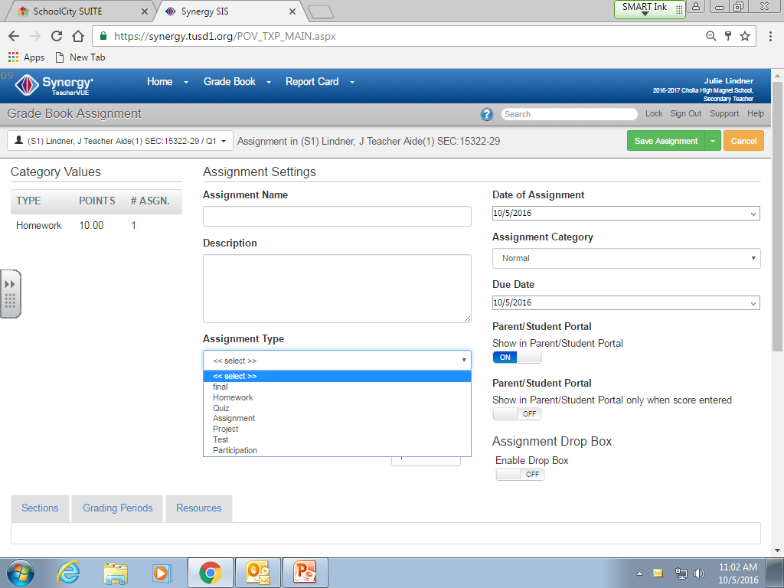
Pick the category that you want it under

Slide 4
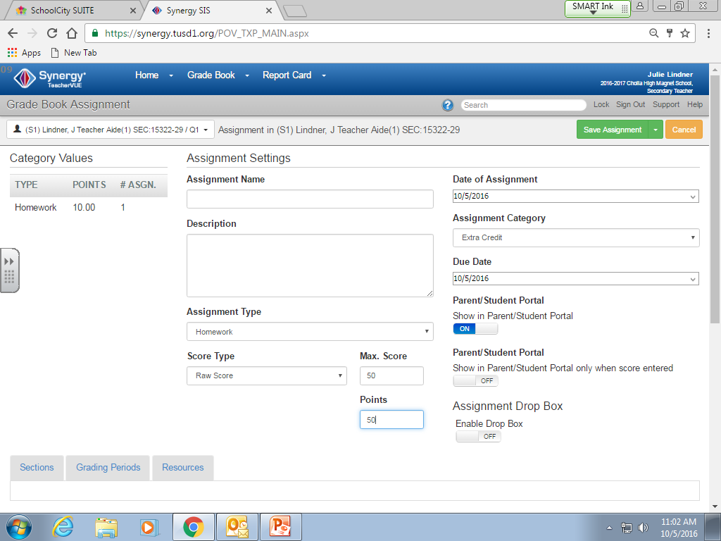
Make sure that the max score and the total points match

