Slide 1
Setting Semester Grades

Slide 2
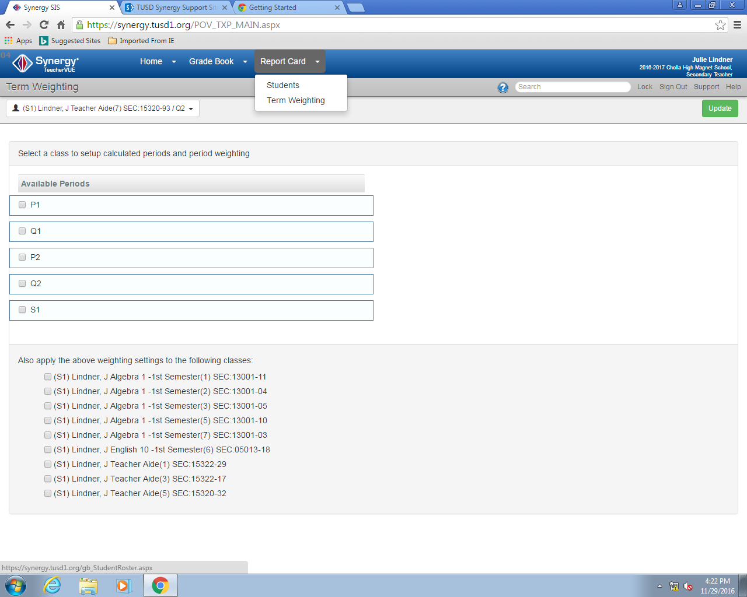
1, click on term weighting
Make sure there is no check mark here
Check all of your classes

Slide 3
Hit update

Slide 4
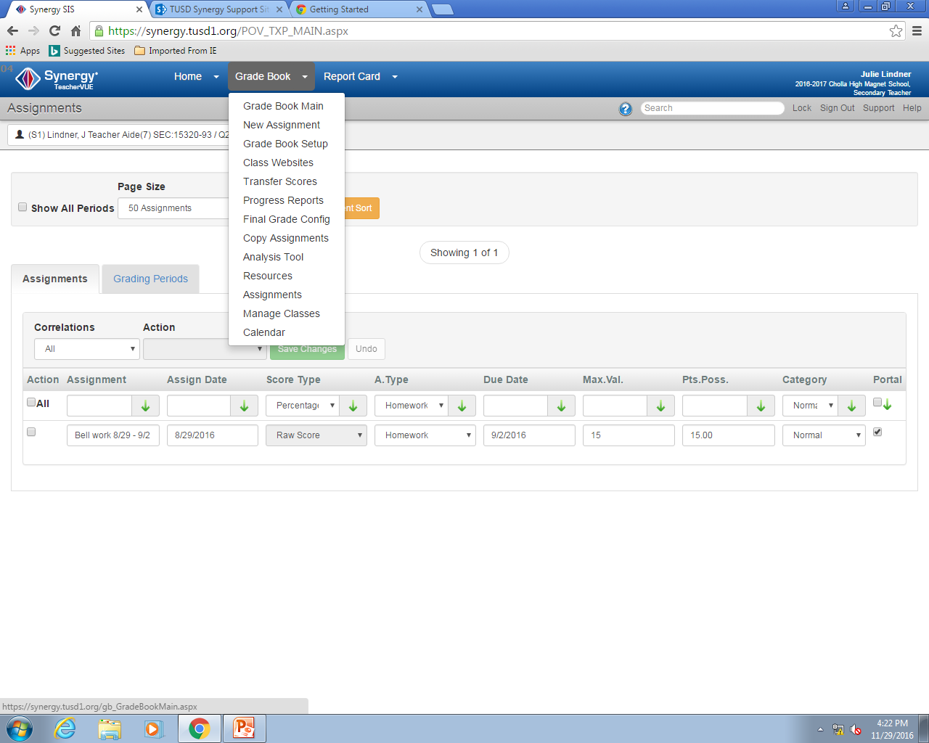
Click on grade book
Click on assignments

Slide 5
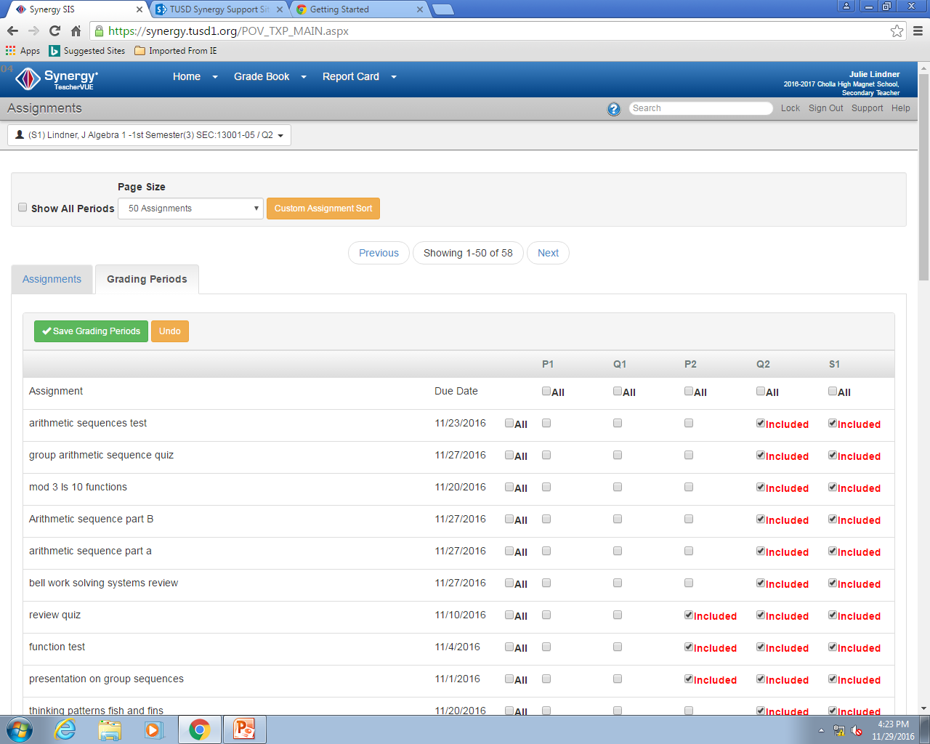
Make sure it is set to 50 assignments
2) Make sure to click
1) Click on grading periods

Slide 6
Do this for all assignments (especially if you have more than 50)
Make sure to save

Slide 7
Make sure that all of your Q1 grades are also checked for Q2 and S1 please using the same process but just changing the focus.

Slide 8
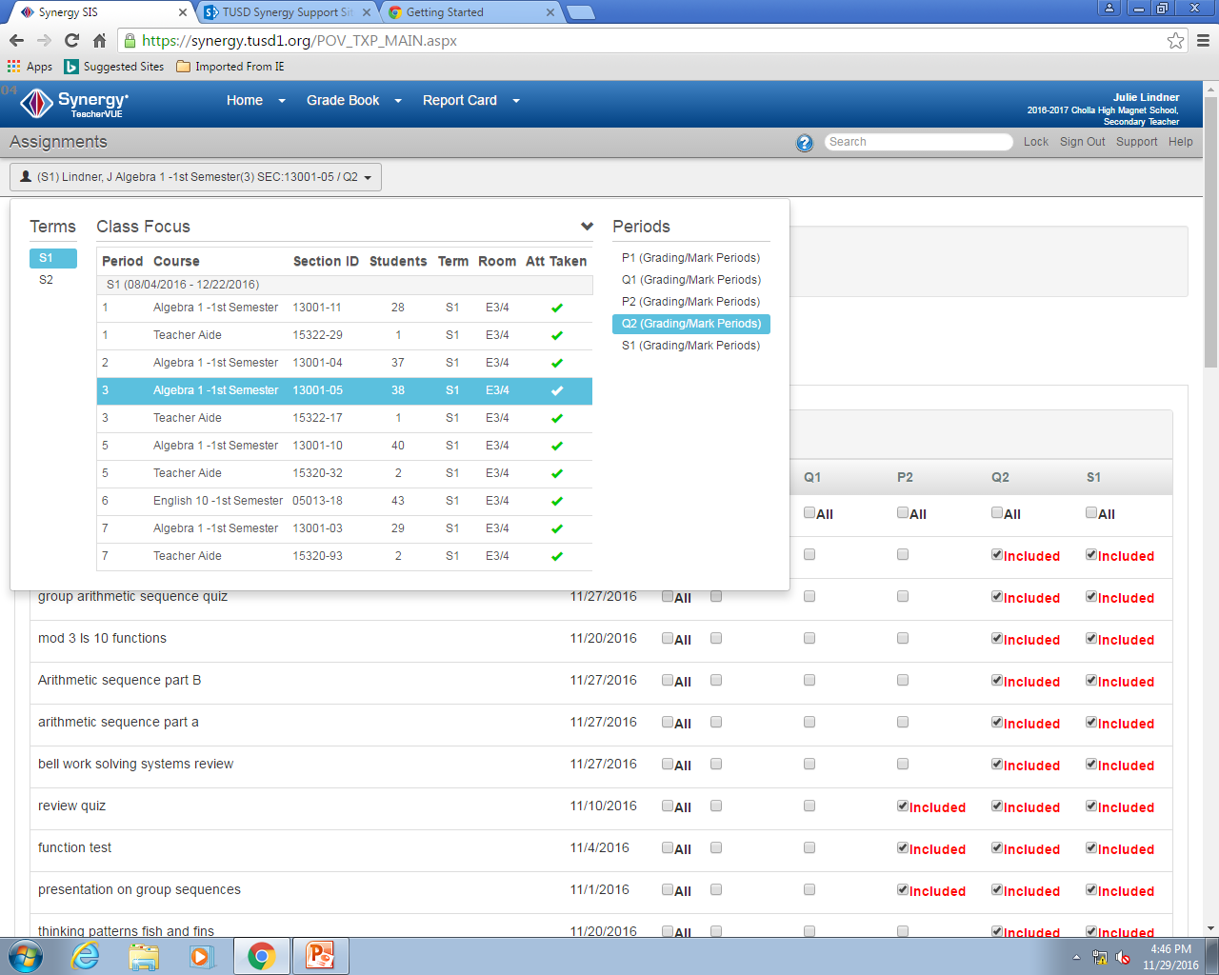
To change focus
Change focus here

